Slide 1

Rumor Detection in Online Social Networks Presented by Kale Ashish Anil 14IT60R03 Under the Guidance of Dr. Shamik Sural
Dept. of Computer Science and Engineering
Indian Institute of Technology, Kharagpur

Slide 2
Contents
Introduction
Twitter Terminology
Related Work
Overall System Architecture
Data Collection
Data Filtering
Part-of-Speech Tagging
Tweet Clustering
Analysis – Temporal,Burst,Data
Future Work

Slide 3
Introduction
Online social networks allows rapid propagation of information
No one to verify the authenticity of the information provided
May lead to spread of rumors
Rumor
Controversial
Fact-checkable statement
Identify potential rumors in Twitter data
Extract features relevant to rumor

Slide 4
Twitter Terminology
Twitter is a social communication tool where people broadcast short messages
Tweet
Each message written on Twitter is called a tweet, limited to 140 characters in length
Follower
Follow another user to see his or her updates on your Twitter home page
User Mention
Twitter allows user to mention other user in a tweet using @ symbol
Hashtag
Using # symbol a user can enrich the subject being discussed in the tweet

Slide 5
Related Work
Qazvinian,Rosengren,Radev,Mei[1],2011
Annotate a set of tweets
Uses network, content and Twitter features
Predict whether a new tweet contains a known rumor or not
The work is mainly targeted to retrieve a set of related rumors
Does not detect new types of rumors
Zhao,Resnick,Mei[2],2015
Partition tweets in 2 sets
Signal - Contains enquiry patterns eg. Really?, Is it true?, what?, rumor, debunk
Non-signal - Rest of the tweets
Form rumor cluster using Jaccard similarity between signal tweets

Slide 6

Overall System Architecture
Word -> Tag
Data Collection
Data Filtering
POS Tagging
Signal Tweet Clustering
Non Signal Tweet Clustering
Combine clusters
Extract Cluster Features
Classify Tweet Clusters
Tweets
Signal Tweets
Non Signal Tweets

Slide 7
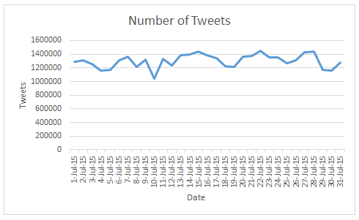
Data Collection
1.3 million tweets on average

Slide 8
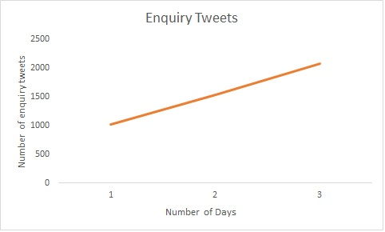
Data Filtering
Signal/Enquiry tweets – set of tweets enquiring about the fact
is it true?
what??
really!
debunk
It is not true
Non-signal tweets – Other tweets

Slide 9
Part-of-Speech Tagging
RT @brownjenjen : Ben Affleck denies affair rumors #rumor http://t.co/qwrfe
Part-of-Speech | Tag
RT | Re-tweet
@brownjenjen | User-mention
: | Discourse marker
Ben | Proper Noun
Affleck | Proper Noun
denies | Verb
affair | Common Noun
rumors | Common Noun
#rumor | Hashtag
http://t.co/qwrfe | URL

Slide 10

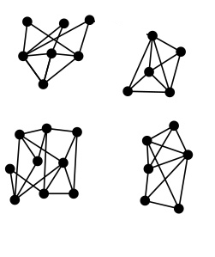
Signal Tweet Clustering
Cluster Features
Cluster 1
-----------------
Proper Noun 1
Proper Noun 2
URL 1
Cluster 2
----------------
Proper Noun 3
Proper Noun 4
URL 2
Signal Tweets
Node=Tweet
Word1
Word2
Word3
Word4
Word5
…
Proper Noun
URL
Verb
Verb
Common Noun
Hashtag
Connected Components => Candidate rumor cluster
POS tagging

Slide 11

Tweet Similarity
Jaccard
Proper Noun
Proper Noun + URL
J(a,b)>0
0
1
Obama http://t.co
a
b
Sachin
Obama
Obama
1
J(b,c)=0
2
c
Obama
Obama http://t.co

Slide 12
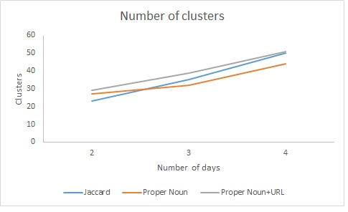
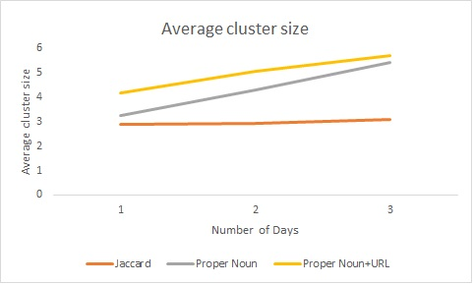
Tweet Similarity Performance
Proper Noun+URL Tweet similarity measure gives overall good performance
Average cluster size does not increase for Jaccard as word diversity increases

Slide 13
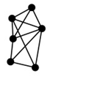
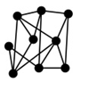
Non-Signal Tweet Clustering
Hadoop Job 1
Word1
Word2
Word3
Word4
Word5
…
Proper Noun
URL
Verb
Adjective
Adverb
Hashtag
Hadoop Job 2
.
.
.
Non-Signal Tweets
POS tagging
Hadoop Job n

Slide 14
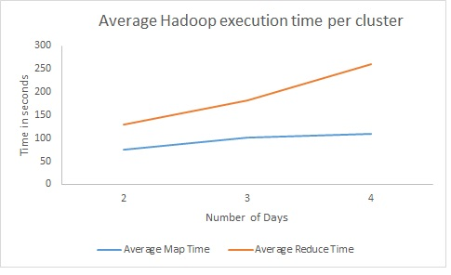
Clustering Time

Slide 15
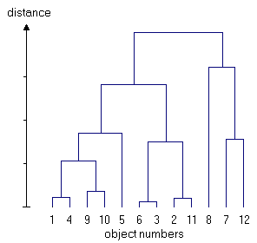
Combining Clusters
Day 1
Day 2
-Remove punctuation
-Remove extra white space
-Convert to lowercase
-Remove stop-words
Day n
-Word level Jaccard

Slide 16
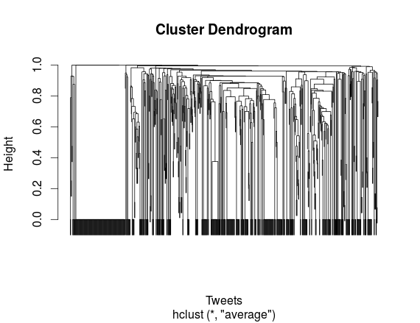
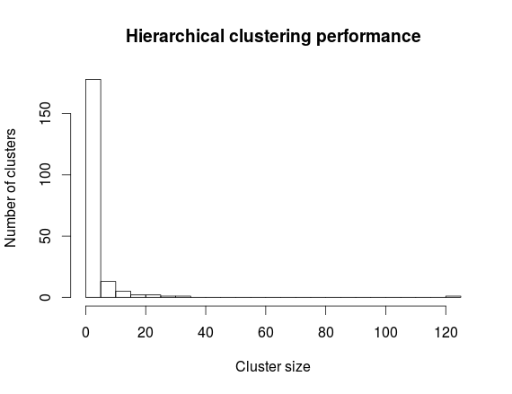
Combining Clusters(Contd..)
Sparsity of words creates small clusters
Need to merge clusters using some other measure as well – POS tags

Slide 17
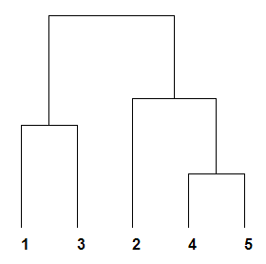
Combining Clusters(Contd..)

Slide 18
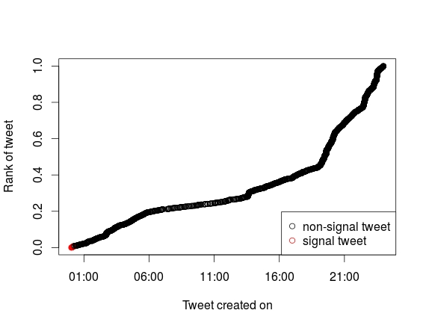
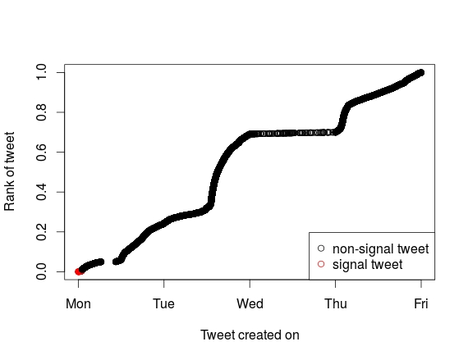
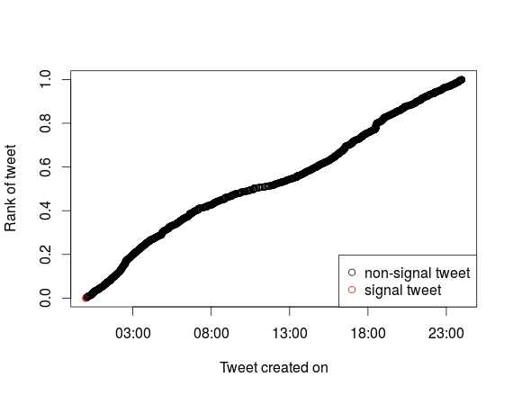
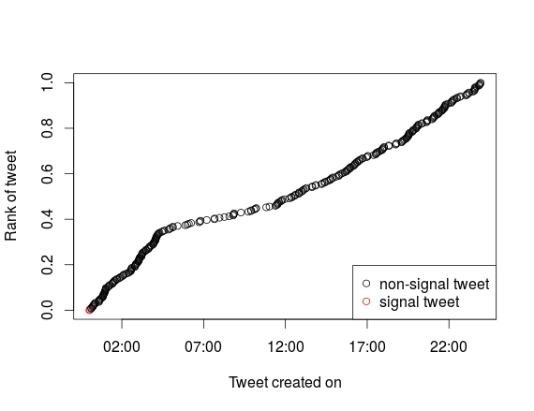
Temporal Analysis – Non-Rumor

Slide 19
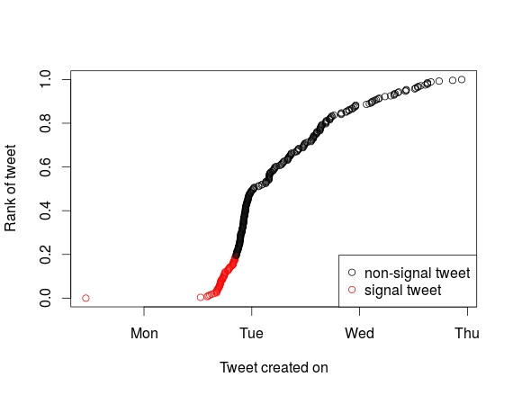
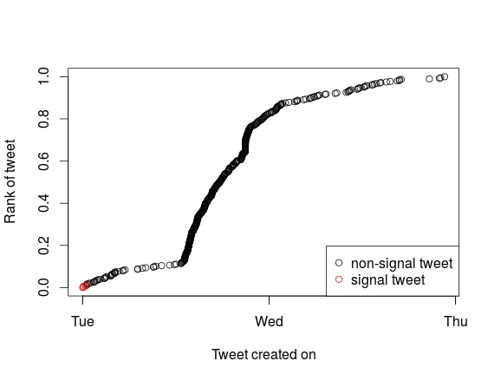
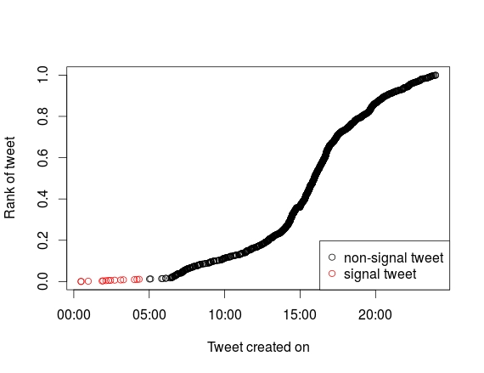
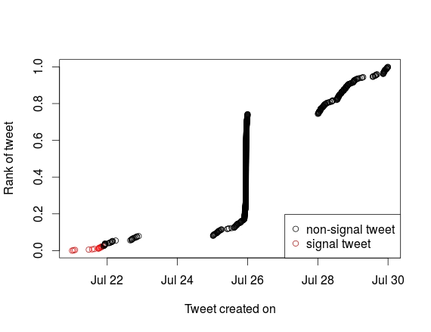
Temporal Analysis – Rumor

Slide 20
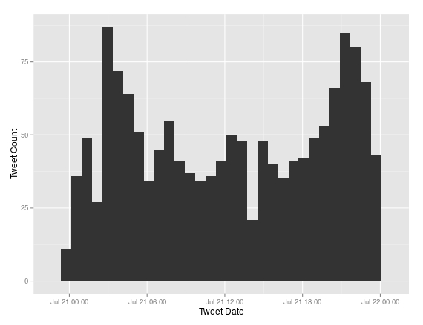
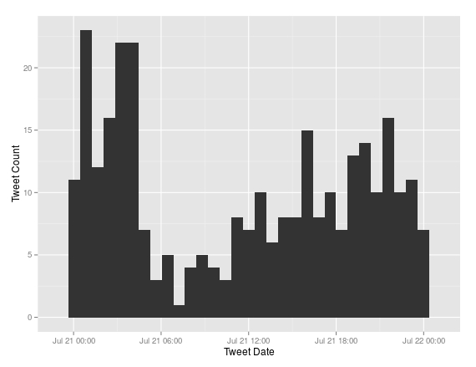
Burst Analysis – Non-Rumor

Slide 21
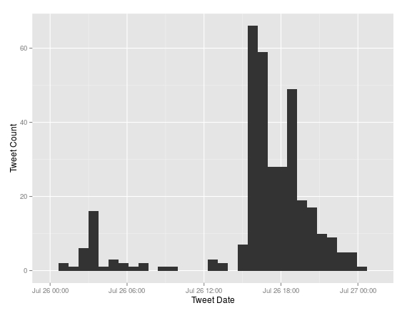
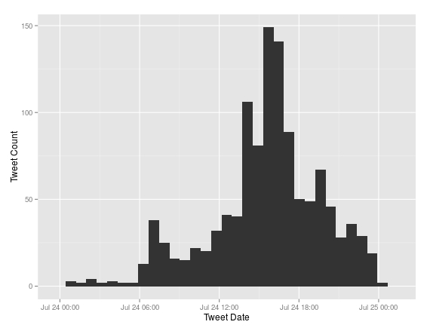
Burst Analysis – Rumor

Slide 22
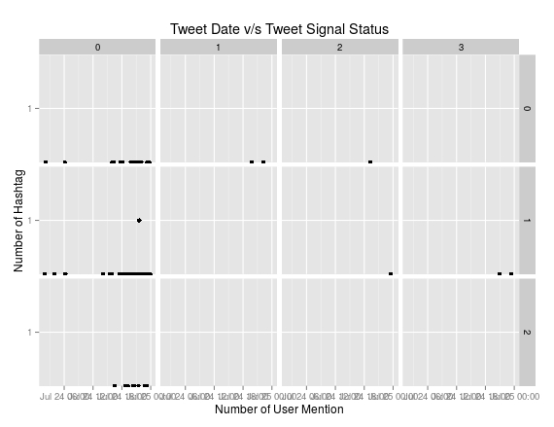
Data Analysis – Non-Rumor

Slide 23
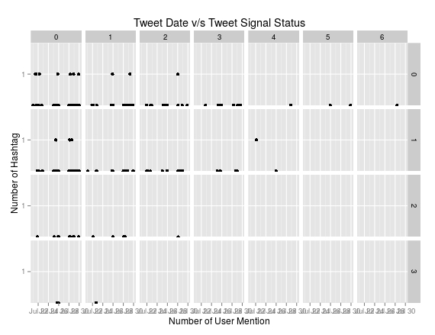
Data Analysis – Rumor

Slide 24
Future Work
Linking to semantic web
Design of classifier using temporal as well as non-temporal properties
Extend system to other media platforms (social and traditional)
Predict the impact of rumors
Strategies for dampening the effects of rumors

Slide 25
THANK YOU!

Slide 26
References
[1] Vahed Qazvinian, Emily Rosengren, Dragomir R Radev, and Qiaozhu Mei. Rumor has it: Identifying misinformation in microblogs. In Proceedings of the Conference on Empirical Methods in Natural Language Processing, pages 1589–1599. Association for Computational Linguistics, 2011.
[2] Zhe Zhao, Paul Resnick, and Qiaozhu Mei. Enquiring minds: Early detection of rumors in social media from enquiry posts. In Proceedings of the 24th International Conference on World Wide Web,pages 1395–1405. International World Wide Web Conferences Steering Committee, 2015.
[3] Kevin Gimpel, Nathan Schneider, Brendan O’Connor, Dipanjan Das, Daniel Mills, Jacob Eisenstein,Michael Heilman, Dani Yogatama, Jeffrey Flanigan, and Noah A Smith. Part-of-speech tagging for twitter: Annotation, features, and experiments. In Proceedings of the 49th Annual Meeting of the Association for Computational Linguistics: Human Language Technologies: short papers-Volume 2,pages 42–47. Association for Computational Linguistics, 2011.
[4] Tom White. Hadoop: The definitive guide. " O’Reilly Media, Inc.", 2012.

